Slide 1
PDA Lab3 OpenROAD Tutorial Advisor: Mark Po-Hung Lin TA: 吳瑞宸 林酩荏

Slide 2
Introduction
OpenROAD is the leading open-source, foundational application for semiconductor digital design. The OpenROAD flow delivers an Autonomous, No-Human-In-Loop (NHIL) flow, 24 hour turnaround from RTL-GDSII for rapid design exploration and physical design implementation.
Doc
Github

Slide 3
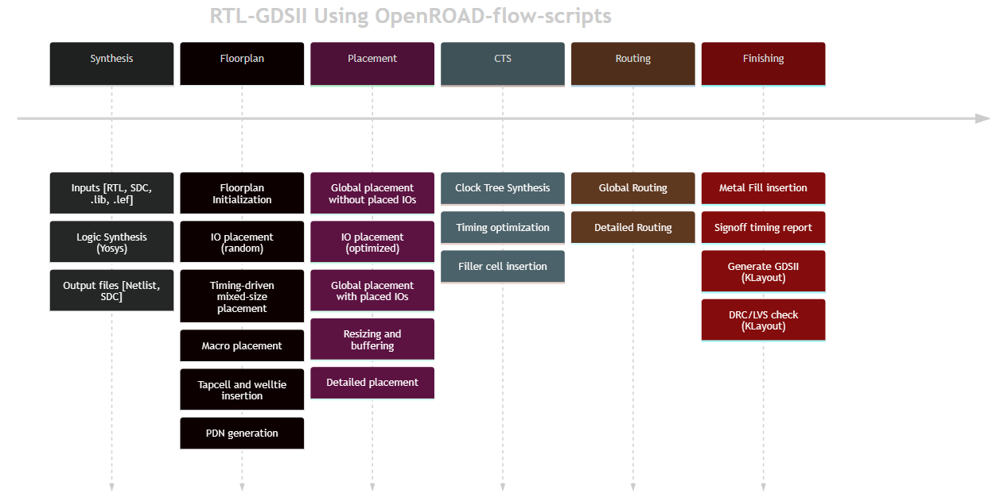
Flow

Slide 4
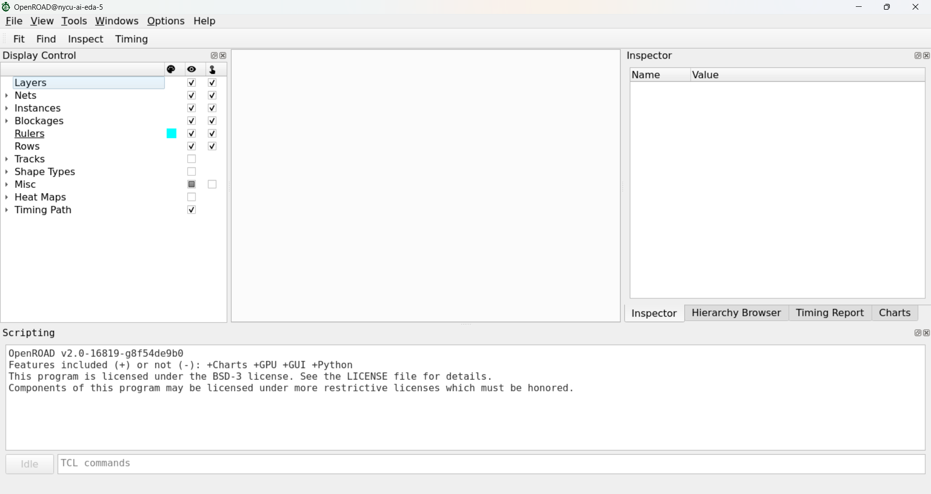
Openroad
$ openroad -gui &
You can operate in tcl shell
Layout area
inst information
Display panel
- Instances
- Rows
- Heat Maps
output log
tcl command

Slide 5
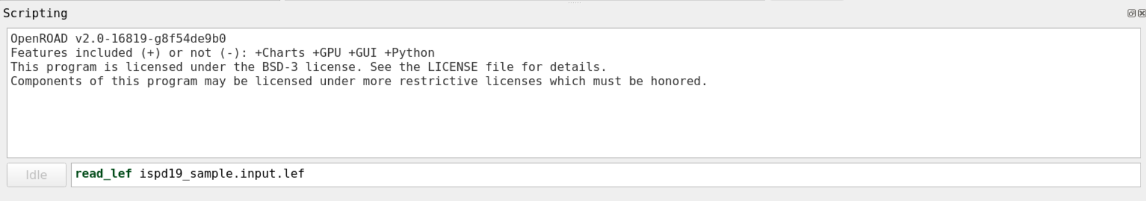
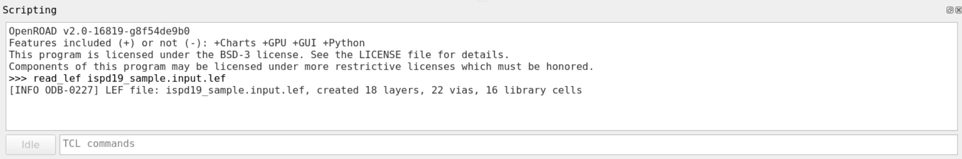
Load files (lef)

Slide 6
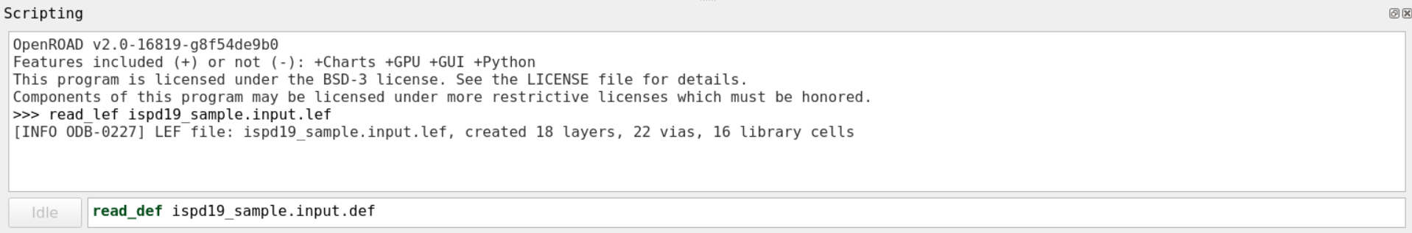
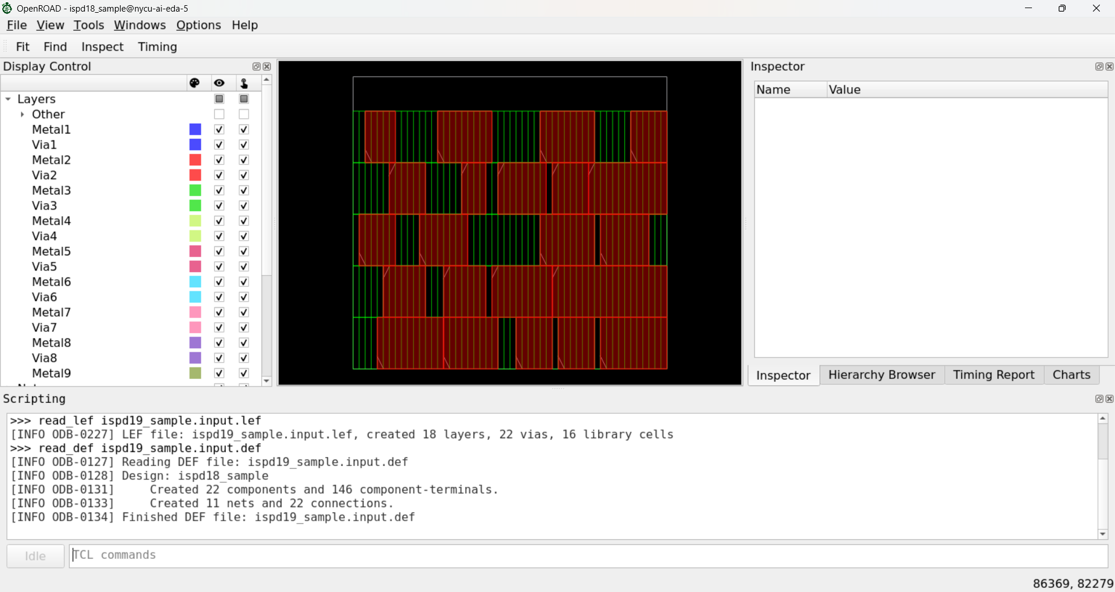
Load files (def)

Slide 7
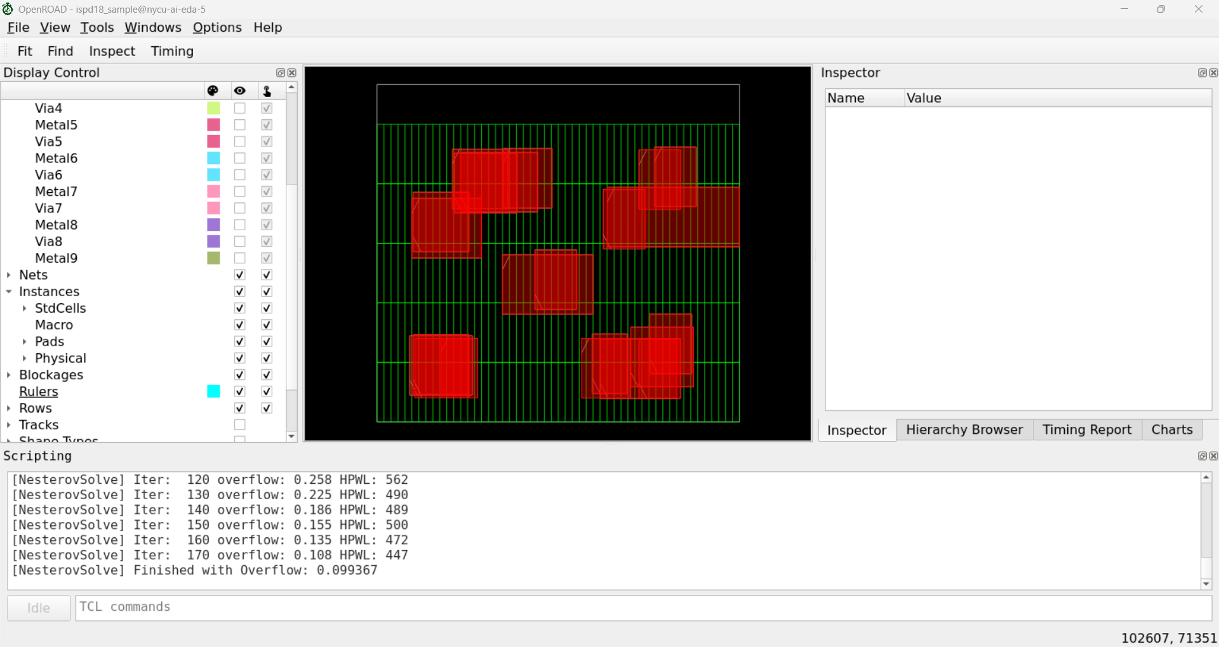
global_placement
$ global_placement -density <value>
Value recommend from 0.8 to 0.95 depends on case

Slide 8
extract
$ source extract.tcl
Filename: designName_insts.gp
DBU_Per_Micron 2000
DieArea_LL 83600 71820
DieArea_UR 104400 91200
Site_Width 400
Site_Height 3420
Name LLX LLY Width Height Type
inst2015 85600 78660 3200 3420 CELL
inst2591 88800 85500 4400 3420 CELL
inst2908 94800 82080 2800 3420 CELL
…

Slide 9
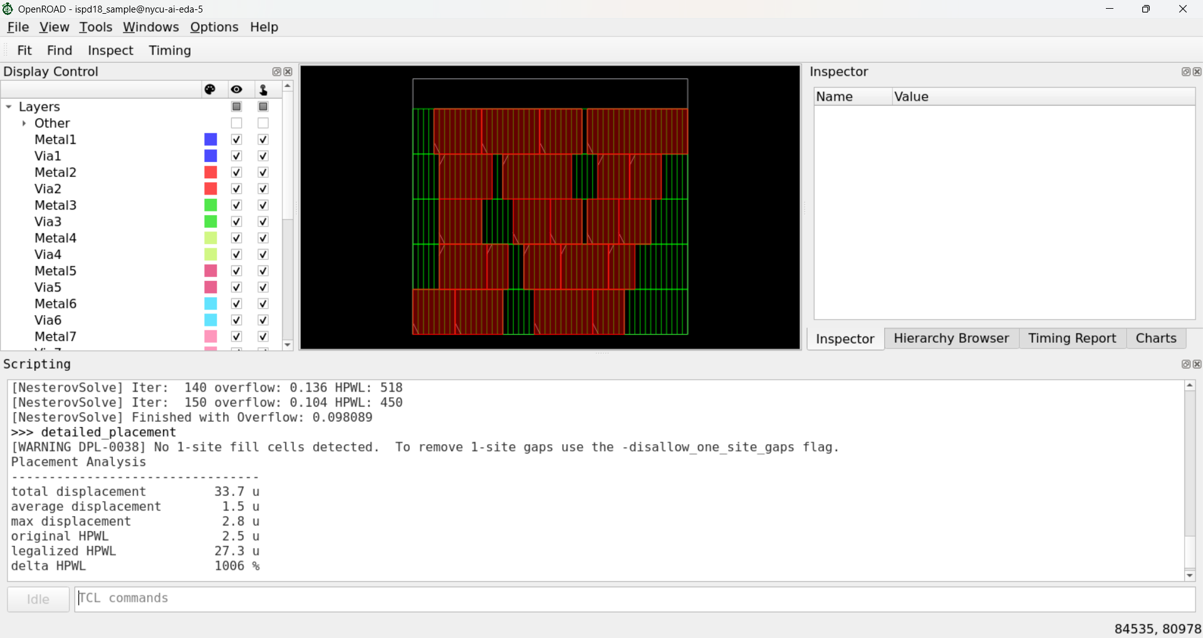
detail_placement & legalization
$ detail_placement
OpenROAD would have some statistics.

Slide 10
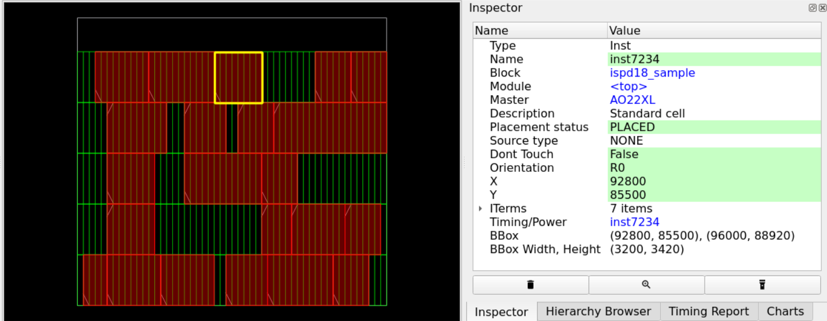
Cell information
The inspector shows the information such as inst_name, status, orientation, bounding box, width, height.

Slide 11
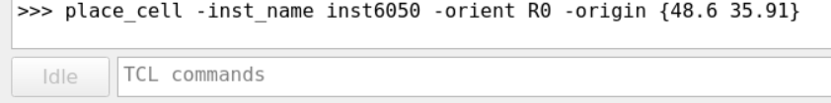
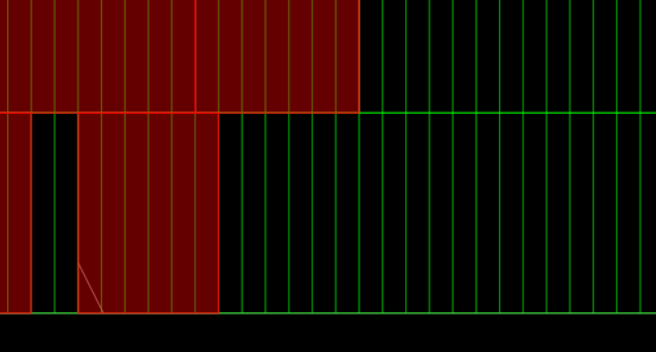
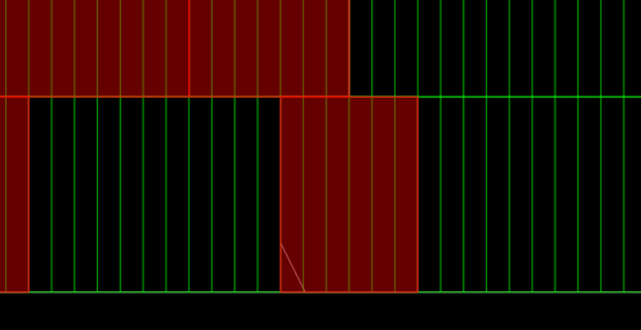
place_cell

Slide 12
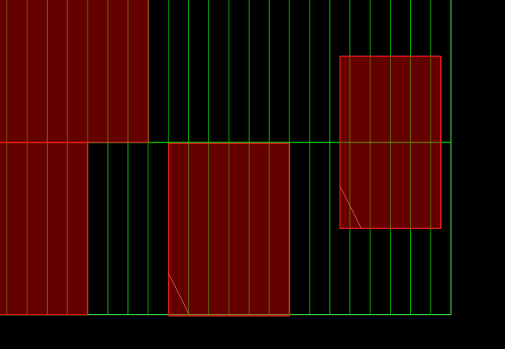
Legality
On-site: Cells must be placed with their bottom-left corner aligned to the site grid defined by the input design data.
Illegal
On-site

Slide 13
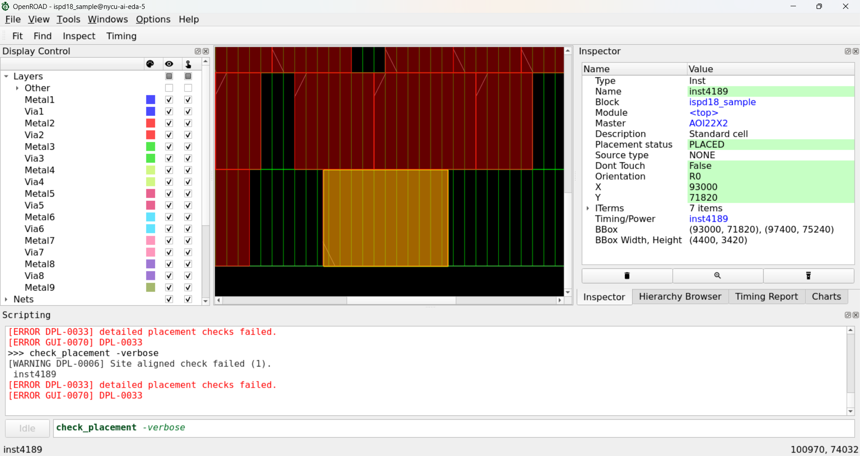
Legality check
$ check_placement -verbose # return 0 if pass

Slide 14
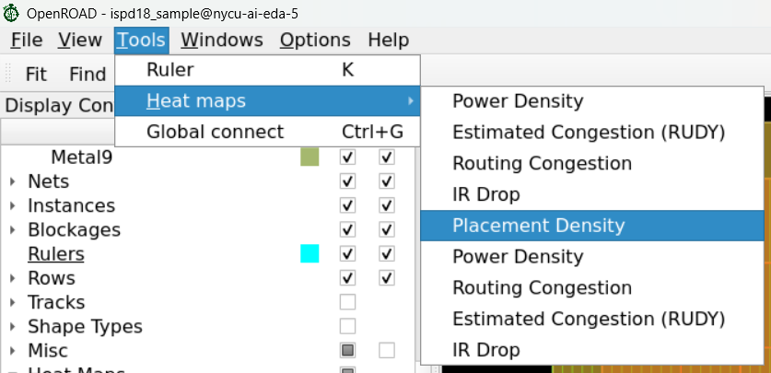
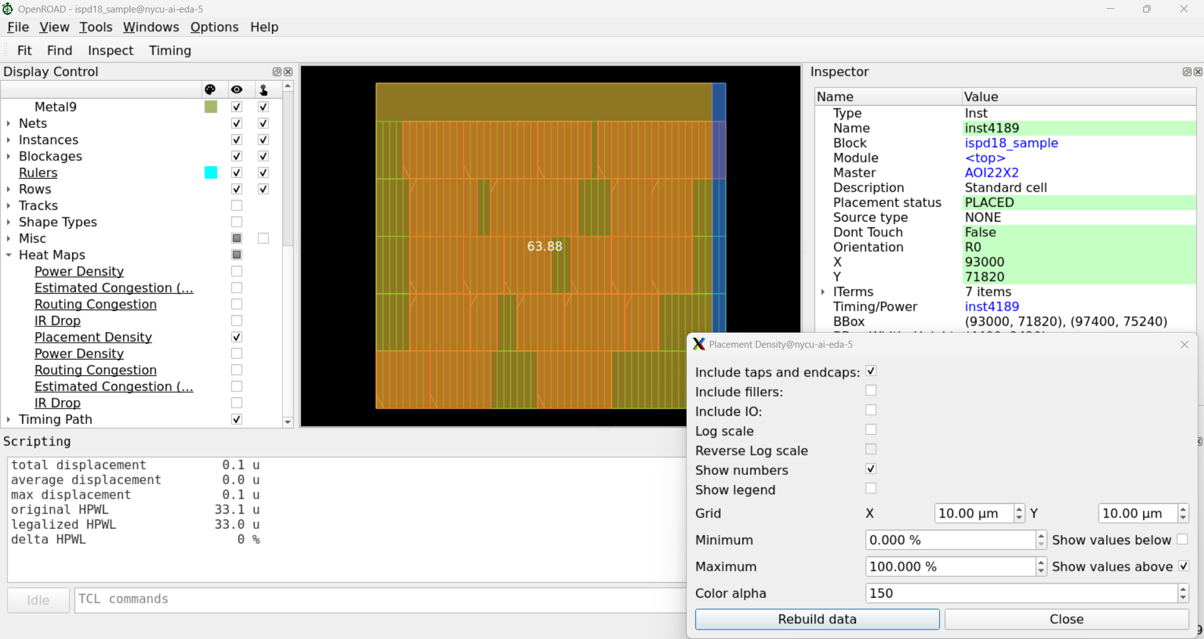
Heatmap

Slide 15
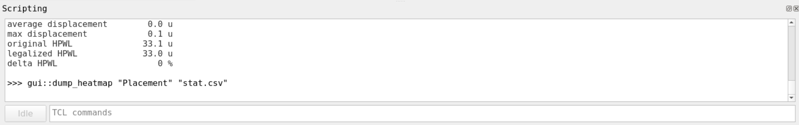
Heatmap Density
$ gui::dump_heatmap "Placement" “<path to csv>”
x0 | y0 | x1 | y1 | value
41.8 | 35.91 | 51.8 | 45.6 | 63.88235
51.8 | 35.91 | 52.2 | 45.6 | 17.64706

Slide 16
Note
flow.tcl # Overall flow wrapper
extract.tcl # Extract input.gp
Please use mobaxterm to connect to the server, DO NOT use vscode ssh
Server ip:140.113.30.188:7405
Account: same
Password: nycu2026

